Slide 1
LDAP

Slide 2
Contents
Introduction
Protocol
Architecture
Operations
Schemas

Slide 3
Introduction
Today people and businesses rely on networked computer systems to support distributed applications.
Applications might interact with computers on the same local area network, within a corporate intranet, within extranets linking up partners and suppliers, or anywhere on the worldwide Internet.
To improve functionality and ease-of-use, and to enable cost-effective administration of distributed applications:
  information about the services, resources, users, and other objects accessible from the applications needs to be organized in a clear and consistent manner.
  Much of this information can be shared among many applications.
  But it must also be protected
Such information is often collected into a special database that is sometimes called a directory.
The Lightweight Directory Access Protocol (LDAP) is an open industry standard that has evolved to meet these needs.
LDAP defines a standard method for accessing and updating information in a directory.
LDAP has gained wide acceptance as the directory access method of the Internet and is therefore also becoming strategic within corporate intranets.

Slide 4
Directories
A directory is a listing of information about objects arranged in some order that gives details about each object.
Common examples are a city telephone directory and a library card catalog.
In computer terms, a directory is a specialized database, also called a data repository, that stores typed and ordered information about objects.
A particular directory might list information about printers (the objects) consisting of typed information such as location (a formatted character string), speed in pages per minute (numeric), print streams supported (for example PostScript or ASCII), and so on.

Slide 5
Directory vs Database
A directory is often described as a database
But it has special characteristics different from general databases:
  They are accessed much more than they are updated. Hence they are optimized for read access
  They are not suited for information that changes rapidly (e.g. number of jobs in a printer queue)
  Many directory services don’t support transactions
  Directories normally limits the type of information that can be stored
  Databases use powerful query languages like SQL but Directories normally use very simple access methods
  Hence directories can be optimized to economically provide more applications with rapid access

Slide 6
Strengths/Limitations
LDAP is well suited for
  Information that is referenced by many entities and applications
  Information that needs to be accessed from more than one location
    Roaming, e.g. by “Road Warriors”
    Preference information for web “portals”
  Information that is read more often than it is written
LDAP is not well suited for
  Information that changes often (it is not a relational database)
  Information that is unstructured (it is not a file system)
Notes:
LDAP directories are particularly useful for storing information that is used by many different entities and applications. For instance, white pages services (address books), email directories, and payroll all want largely the same information with respect to people objects. It is wasteful and error prone to try to maintain this information in separate directories.
LDAP directories are also useful for housing information that is used by only one application, but the user can access the application from many different locations. For instance, consider an email server, which needs to store the user’s email address, post office location, mail aliases, etc. If stored on the client, the user must re-create that information wherever he logs into the mail server. If stored in a directory, the server and/or client can retrieve the information wherever the user logs in. A portal like Netscape Netcenter or the MOP are other examples of a directory where user information (preferences, mailbox location, etc.) is stored to be retrieved and used wherever a user logs in.
But it is important to keep in mind that LDAP is a directory, and intended for hierarchical data that is read much more often than it is written. It is not a general purpose relational database or file system. That is not to say that it can’t contain pointers to unstructured information, e.g., URL to resumes, etc.

Slide 7
LDAP protocol
A message protocol used by directory clients and servers.
It defines several messages like bindRequest and searchRequest
There is LDAP API to be used by C and Java programs
With Microsoft it can by accessed via ADSI
All modern LDAP servers are based on LDAP version 3.
Clients and servers may or may not be on the same machine

Slide 8
Type of directories
Local: means nearby for example information about names, email addresses and so on for a department or for a workgroup
Global: Something is spread across the universe of interest. For example information about persons in an entire company.
Centralized: there is one directory server at one location. Local or remote clients can access it.
Distributed: information may be partitioned or replicated.

Slide 9
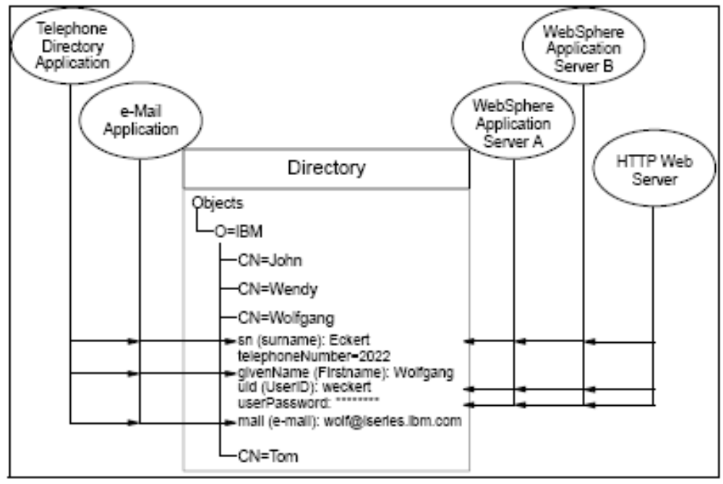
Directories advantages

Slide 10
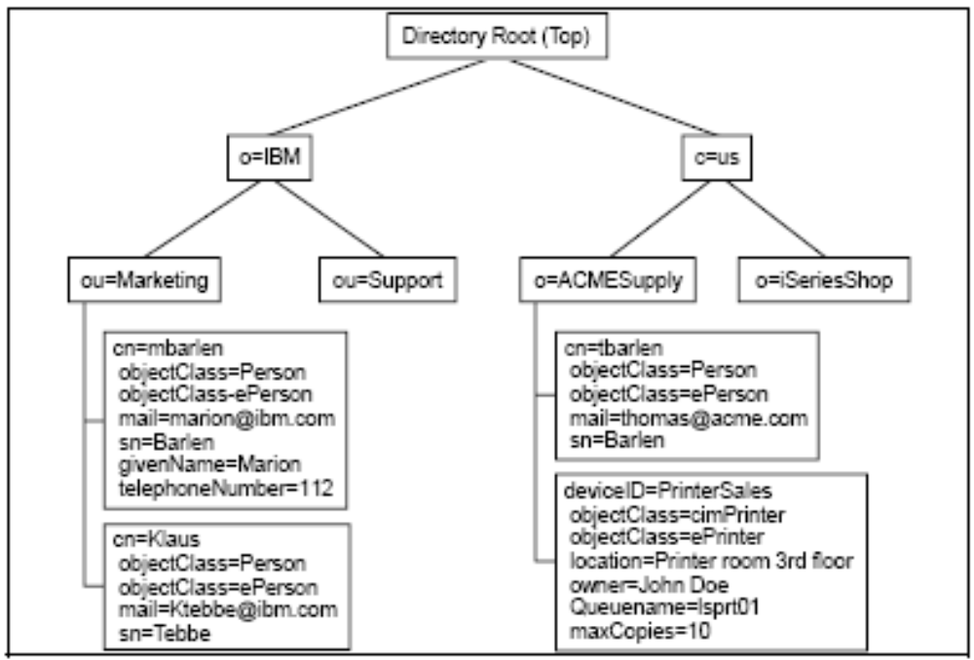
Directory structure

Slide 11
LDAP architecture overview
A typical entry serialized in LDIF:
  dn: cn=John Doe,dc=example,dc=com
  cn: John Doe
  givenName: John
  sn: Doe
  telephoneNumber: +1 555 6789
  telephoneNumber: +1 555 1234
  mail: john@example.com
  manager: cn=Barbara Doe,dc=example,dc=com
  objectClass: inetOrgPerson
  objectClass: organizationalPerson
  objectClass: person
  objectClass: top

Slide 12
Distinguished Names
Each object in the LDAP directory has a DN
  uid=jheiss,ou=people,dc=example,dc=com
  cn=users,ou=group,dc=example,dc=com
Notice that the DNS name is example.com (specified by DC=Domain Component entries) for the domain
OU is organizational unit
Each domain subdomain could create a tree structure in LDAP (engr.example.com, sales.example.com, pre.engr.example.com, support.engr.example.com, etc)

Slide 13
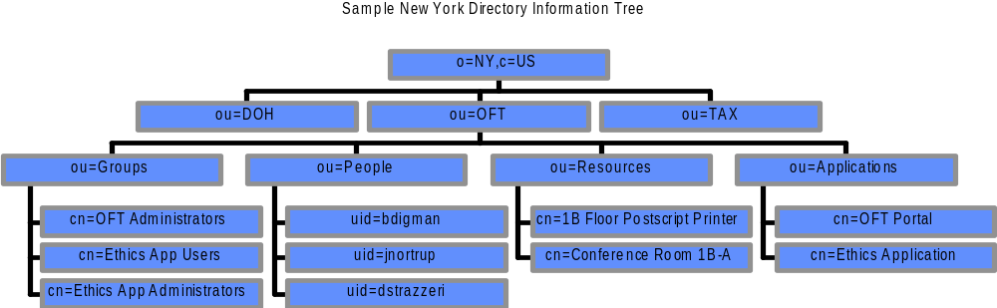
Sample DIT
Branched by agency
Agencies in this example have branches containing:
  Groups which contain people
  People in the organization
  Resources such as printers and conference rooms
  Applications (where application specific info. could be maintained)
Notes:
The above sample directory information tree (DIT) shows the proposed structure for state of New York.
The tree is rooted at “o=NY,c=US”
The is branched at the agency and locality (e.g., New York City)
Each agency branch is further branched by
A People branch containing all the people in the agency
A Groups branch which will contain groups used for access control, mailing lists, etc.
An optional Resources branch containing agency resources such as printers, conference rooms, etc.
An optional Applications branch where agency applications can contain application-specific information and resources

Slide 14
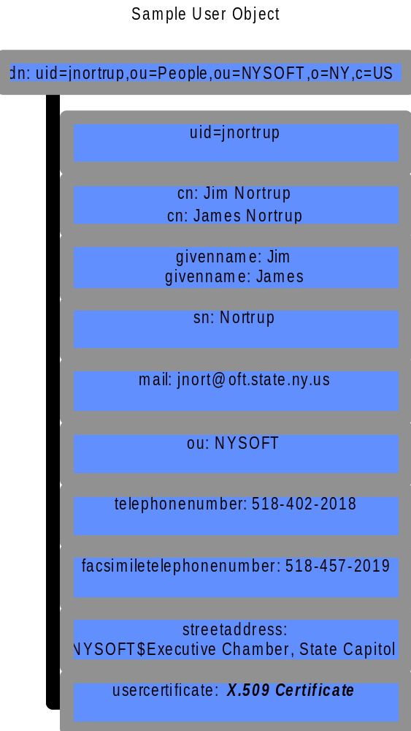
Sample User Object
Objects contain attributes, e.g.,
  uid (user ID)
  cn (common name)
  sn (surname)
  mail (e-mail address)
Attributes can be multi-valued, e.g., givenname of both James and Jim
This object contains
  white-pages information
  X.509 certificate for PKI
Notes:
The above user object shows some representative attributes. Notice that the attributes can contain multiple values. The following attributes have been specified for the NYT directory:

Slide 15
ObjectClass
A commonly used attribute is "objectClass".
Each record represents an object, and the attributes associated with that object are defined according to it's objectClass
  The value of the objectClass attribute.

Slide 16
Object Type examples
Examples of objectClass:
  organization (needs a name and address)
  person (needs name, email, phone & address)
  course (needs a CRN, instructor, mascot)
  cookie (needs name, cost & taste index)

Slide 17
Defining ObjectClass types
You can define what attributes are required for objects with a specific value for the objectclass attribute.
You can also define what attributes are allowed.
New records must adhere to these settings!

Slide 18
Multiple Values
Each attribute can have multiple values, for example we could have the following record:
  DN: cn=Dave Hollinger, O=RPI, C=US
  CN: Dave Hollinger
  CN: David Hollinger
  Email: hollingd@cs.rpi.edu
  Email: hollid2@rpi.edu
  Email: satan@hackers.org

Slide 19
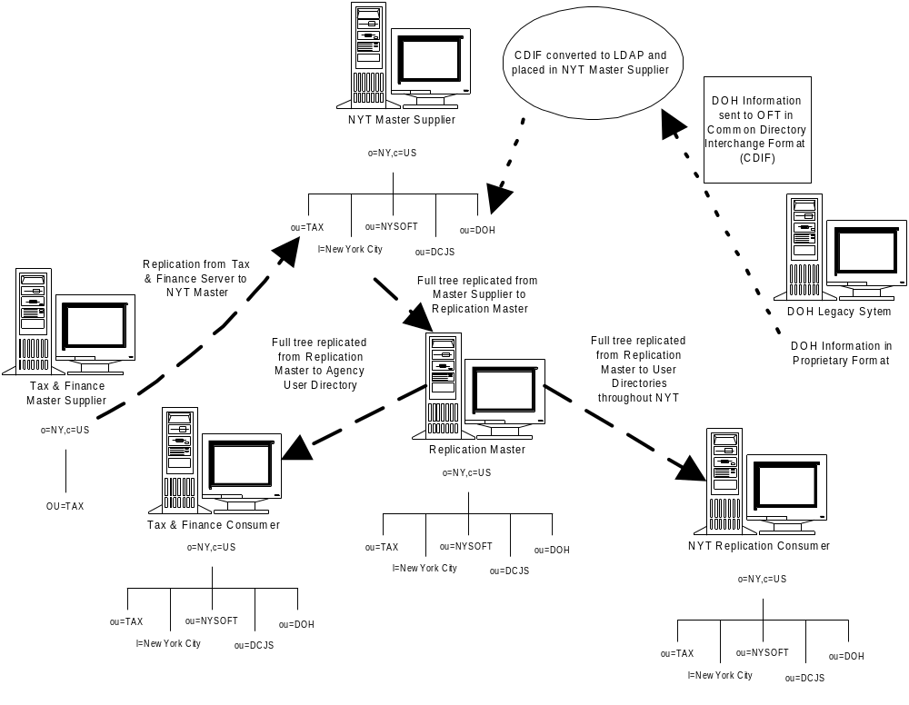
Directory Information Flows
Notes:
This diagram shows several scenarios.
On the far left, an agency LDAP server (Tax & Finance Master Supplier) masters its own data and replicates that to the NYT Master Supplier.
On the upper right, DOH sends its data periodically in Common Directory Interchange Format (CDIF) to the Office for Technology. The OFT then updates the NYT Master Supplier with the data.
Through operations like these, the full tree is populated on the NYT Master Supplier.
The NYT Master replicates to a “Replication Master” which in turn replicates out to all the other directories that would be accessed by users and applications.
In this example, on the lower right hand side is a NYT Replication Consumer (potentially one of many) that would reside on the NYT and be accessible by the general intranet population.
On the lower left hand side is an agency consumer directory (Tax & Finance Consumer) which can provide the full directory to the agency’s users. This might be desirable based on network topology, availability, or bandwidth (e.g., the particular agency users and applications exert a heavy directory load), or the agency merely wishes to have a full directory in their own network.

Slide 20
Basic Operations
Bind - authenticate, and specify LDAP protocol version,
Start TLS - protect the connection with Transport Layer Security (TLS), to have a more secure connection,
  Search - search for and/or retrieve directory entries,
  Compare - test if a named entry contains a given attribute value,
  Add a new entry,
  Delete an entry,
  Modify an entry,
  Modify DN - move or rename an entry,
  Abandon - abort a previous request,
  Extended Operation - generic operation used to define other operations,
Unbind - close the connection, not the inverse of Bind.

Slide 21
Bind
authenticates the client to the server
Bind sends the user's DN and password - in cleartext, so the connection should be protected using Transport Layer Security (TLS).
The server typically checks the password against the userPassword attribute in the named entry.
Bind also sets the LDAP protocol version. Normally clients should use LDAPv3.

Slide 22
Start TLS
establishes Transport Layer Security (the descendant of SSL) on the connection.
That can provide data confidentiality protection (hide the data) and/or data integrity protection (protect from tampering).
During TLS negotiation the server sends its X.509 certificate to prove its identity.
The client may also send a certificate to prove its identity.
Servers also often support the non-standard "LDAPS" ("Secure LDAP", commonly known as "LDAP over SSL") protocol on a separate port

Slide 23
Search and Compare
Parameters:
  baseObject - the DN (Distinguished Name) of the entry at which to start the search,
  scope - baseObject (search just the named entry, typically used to read one entry), singleLevel (entries immediately below the base DN), or wholeSubtree (the entire subtree starting at the base DN).
  filter - how to examine each entry in the scope. E.g. (&(objectClass=person)(|(givenName=John)(mail=john*))) - search for persons who either have given name John or an e-mail address starting with john.
  derefAliases - whether and how to follow alias entries (entries which refer to other entries),
  attributes - which attributes to return in result entries.
  sizeLimit, timeLimit - max number of entries, and max search time.
  typesOnly - return attribute types only, not attribute values.

Slide 24
Update operations
Add, Delete, Modify and Modify DN all require the DN of the entry to change
Modify takes a list of attributes to modify and the modifications to each: Delete the attribute or some values, add new values, or replace the current values with the new ones.
Add operations also can have additional attributes and values for those values.
Modify DN (move/rename entry) takes the new RDN (Relative Distinguished Name), optionally the new parent's DN, and a flag which says whether to delete the value(s) in the entry which match the old RDN. The server may support renaming of entire directory subtrees
An update operation is atomic: Other operations will see either the new entry or the old one.

Slide 25
Schemas
The contents of the entries in a subtree is governed by a schema
The schema defines the attribute types that directory entries can contain.
An attribute definition includes a syntax, and most non-binary values in LDAPv3 use UTF-8 string syntax
  For example, a "mail" attribute might contain the value "user@example.com".
  A "jpegPhoto" attribute would contain photograph(s) in binary JPEG/JFIF format.
  A "member" attribute contains the DNs of other directory entries.
Attribute definitions also include whether the attribute is single-valued or multi-valued, how to search/compare the attribute.
The schema defines object classes. Each entry must have an objectClass attribute, containing named classes defined in the schema.
  e.g. a person, organization or domain.
Server administrators can define their own schemas in addition to the standard ones.

Slide 26
OpenLDAP
Open Source LDAP v3 implementation
  Slapd – standalone server daemon
  Slurpd – replication daemon
  Libraries including Java libraries
Included in major Unix distributions (such as SuSE10.0)
Ref: http://www.openldap.org/
Software version 2.3.20 as of today

Slide 27
Active Directory 2003
Microsoft directory services
Uses LDAP
Uses Kerberos 5
Uses DNS (not WINS)
Scalable and available architecture
Extends significantly but does not replace common X.500 schema elements

